Slide 1
Introduction
What is Digital Image Processing?
Digital Image
— a two-dimensional function
x and y are spatial coordinates
The amplitude of f is called intensity or gray level at the point (x, y)
Digital Image Processing
— process digital images by means of computer, it covers low-, mid-, and high-level processes
low-level: inputs and outputs are images
mid-level: outputs are attributes extracted from input images
high-level: an ensemble of recognition of individual objects
Pixel
— the elements of a digital image

Slide 2
A Simple Image Formation Model

Slide 3
Some Typical Ranges of Reflectance
Reflectance
0.01 for black velvet
0.65 for stainless steel
0.80 for flat-white wall paint
0.90 for silver-plated metal
0.93 for snow

Slide 4
Image Sampling and Quantization
Digitizing the coordinate values
Digitizing the amplitude values

Slide 5
Image Sampling and Quantization

Slide 6
Representing Digital Images
The representation of an M×N numerical array as

Slide 7
Representing Digital Images
The representation of an M×N numerical array as

Slide 8
Representing Digital Images
The representation of an M×N numerical array in MATLAB

Slide 9
Representing Digital Images
Discrete intensity interval [0, L-1], L=2^{k}
The number b of bits required to store a M × N digitized image
b = M × N × k

Slide 10
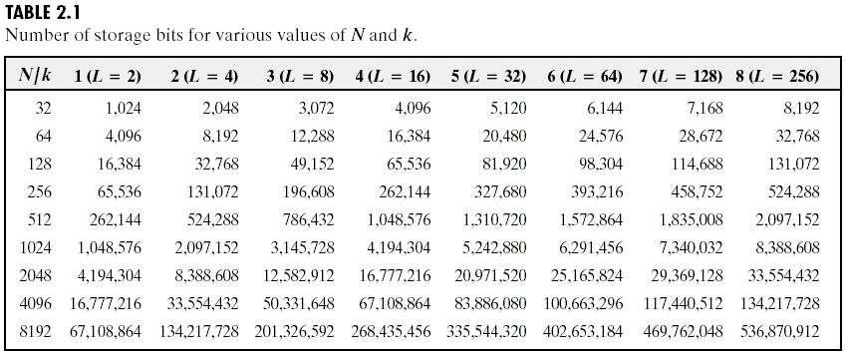
Representing Digital Images

Slide 11
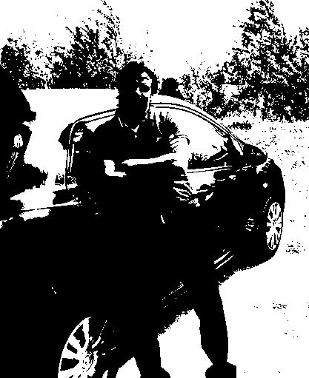


Notes:
As opposed to [0..255]

Slide 12
Key Stages in Digital Image Processing
Image Restoration
Morphological Processing
Image Enhancement
Segmentation
Image Acquisition
Object Recognition
Representation & Description
Problem Domain
Colour Image Processing
Image Compression

Slide 13


Key Stages in Digital Image Processing: Image Aquisition
Image Restoration
Morphological Processing
Image Enhancement
Segmentation
Image Acquisition
Object Recognition
Images taken from Gonzalez & Woods, Digital Image Processing (2002)
Representation & Description
Problem Domain
Colour Image Processing
Image Compression

Slide 14
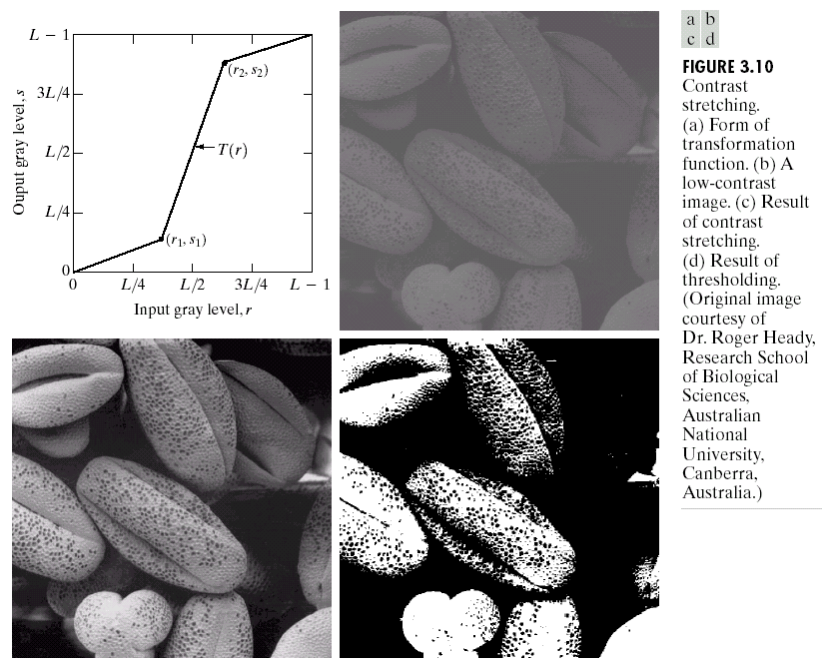
Key Stages in Digital Image Processing: Image Enhancement
Image Restoration
Morphological Processing
Image Enhancement
Segmentation
Image Acquisition
Object Recognition
Images taken from Gonzalez & Woods, Digital Image Processing (2002)
Representation & Description
Problem Domain
Colour Image Processing
Image Compression

Slide 15
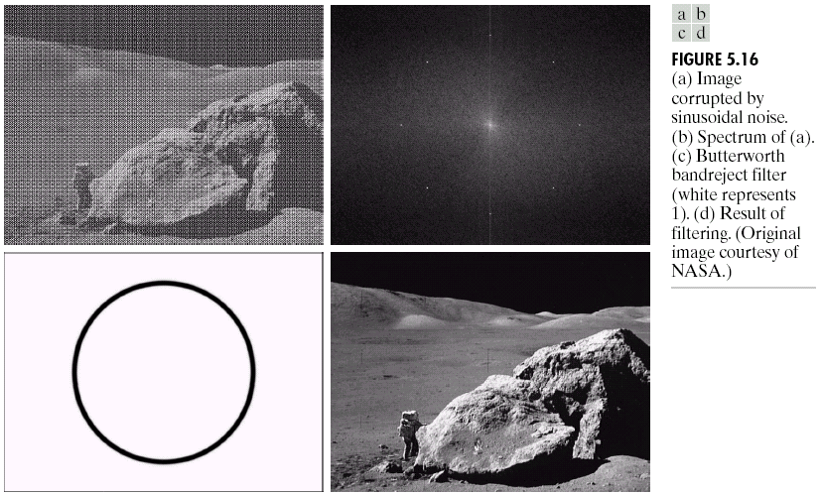
Key Stages in Digital Image Processing: Image Restoration
Image Restoration
Morphological Processing
Image Enhancement
Segmentation
Image Acquisition
Object Recognition
Images taken from Gonzalez & Woods, Digital Image Processing (2002)
Representation & Description
Problem Domain
Colour Image Processing
Image Compression

Slide 16
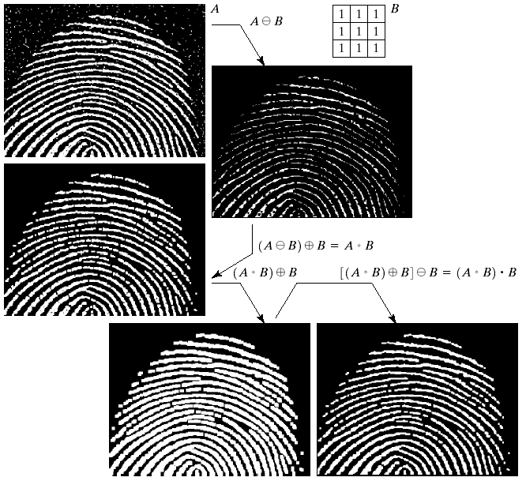
Key Stages in Digital Image Processing: Morphological Processing
Image Restoration
Morphological Processing
Image Enhancement
Segmentation
Image Acquisition
Object Recognition
Images taken from Gonzalez & Woods, Digital Image Processing (2002)
Representation & Description
Problem Domain
Colour Image Processing
Image Compression

Slide 17
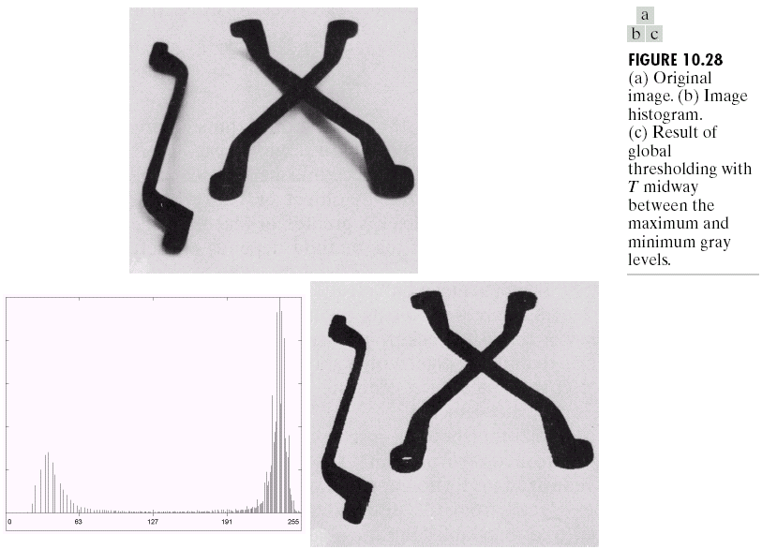
Key Stages in Digital Image Processing: Segmentation
Image Restoration
Morphological Processing
Image Enhancement
Segmentation
Image Acquisition
Object Recognition
Images taken from Gonzalez & Woods, Digital Image Processing (2002)
Representation & Description
Problem Domain
Colour Image Processing
Image Compression

Slide 18
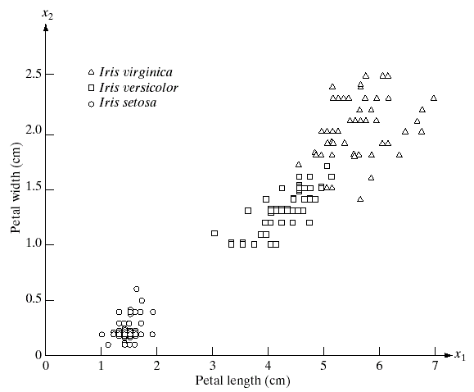
Key Stages in Digital Image Processing: Object Recognition
Image Restoration
Morphological Processing
Image Enhancement
Segmentation
Image Acquisition
Object Recognition
Images taken from Gonzalez & Woods, Digital Image Processing (2002)
Representation & Description
Problem Domain
Colour Image Processing
Image Compression

Slide 19
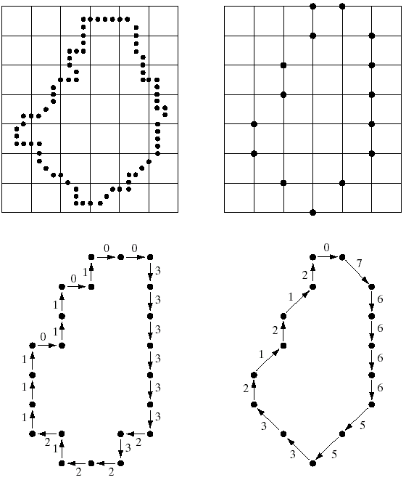
Key Stages in Digital Image Processing: Representation & Description
Image Restoration
Morphological Processing
Image Enhancement
Segmentation
Image Acquisition
Object Recognition
Images taken from Gonzalez & Woods, Digital Image Processing (2002)
Representation & Description
Problem Domain
Colour Image Processing
Image Compression

Slide 20
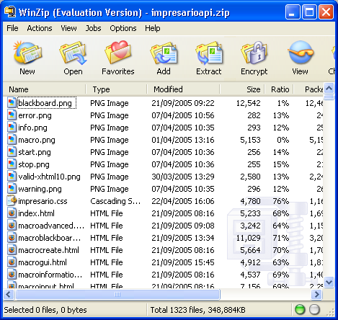
Key Stages in Digital Image Processing: Image Compression
Image Restoration
Morphological Processing
Image Enhancement
Segmentation
Image Acquisition
Object Recognition
Representation & Description
Problem Domain
Colour Image Processing
Image Compression

Slide 21
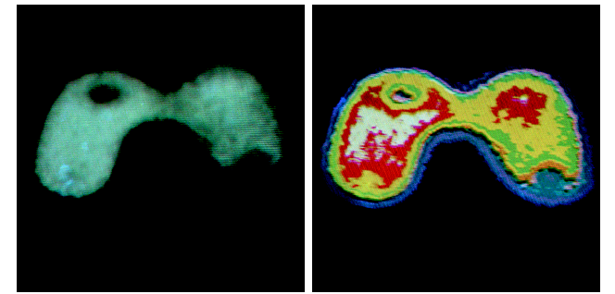
Key Stages in Digital Image Processing: Colour Image Processing
Image Restoration
Morphological Processing
Image Enhancement
Segmentation
Image Acquisition
Object Recognition
Representation & Description
Problem Domain
Colour Image Processing
Image Compression

Slide 22
Applications
&
Research Topics

Slide 23
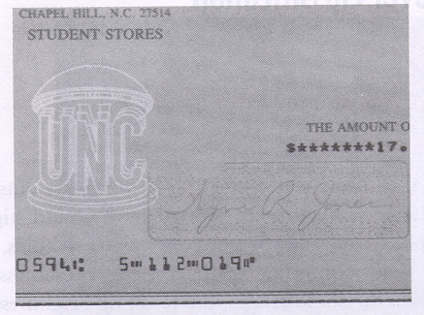
Document Handling

Slide 24

Signature Verification

Slide 25
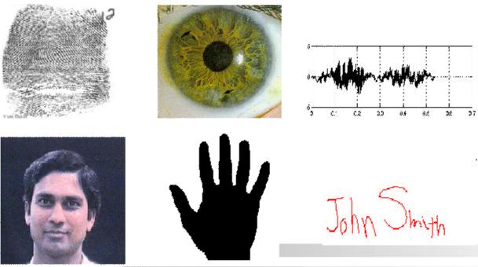
Biometrics

Slide 26
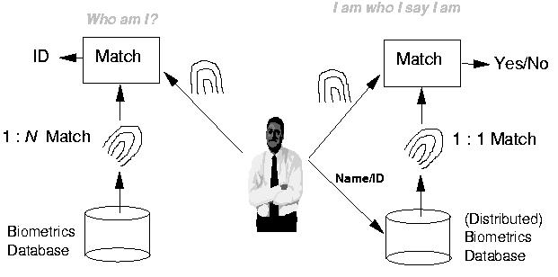
Fingerprint Verification / Identification

Slide 27

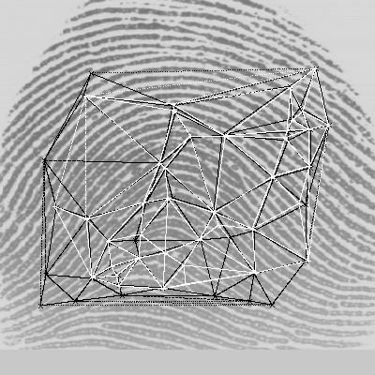
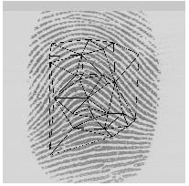
Fingerprint Identification Research at UNR
Minutiae Matching
Delaunay Triangulation

Slide 28

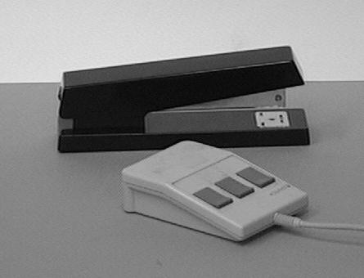
Object Recognition

Slide 29
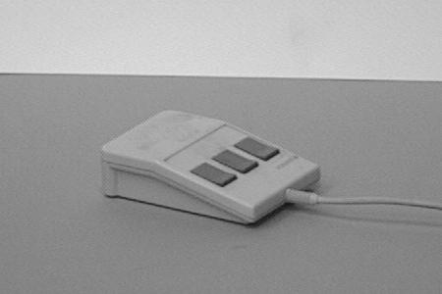
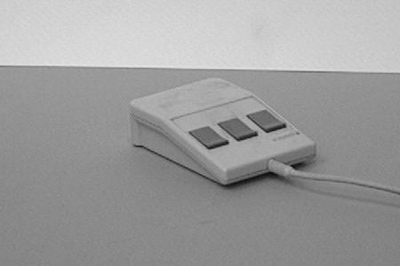
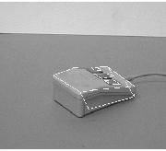
Object Recognition Research
reference view 1 reference view 2
novel view recognized

Slide 30
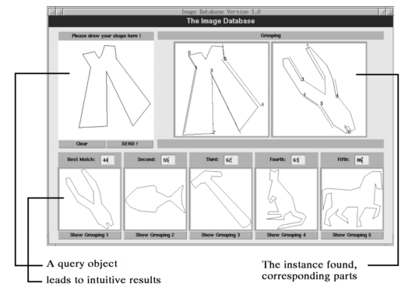
Indexing into Databases
Shape content

Slide 31
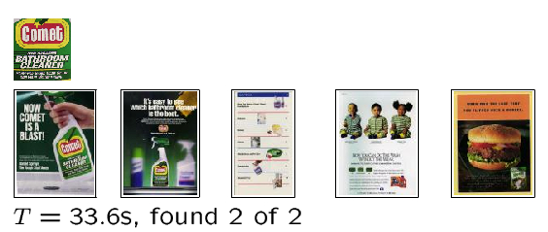
Indexing into Databases (cont’d)
Color, texture

Slide 32
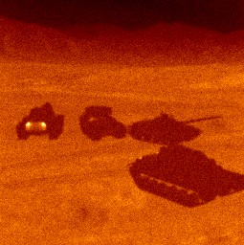
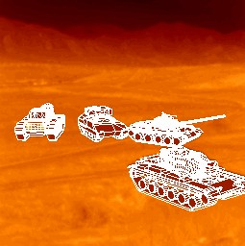
Target Recognition
Department of Defense (Army, Airforce, Navy)

Slide 33
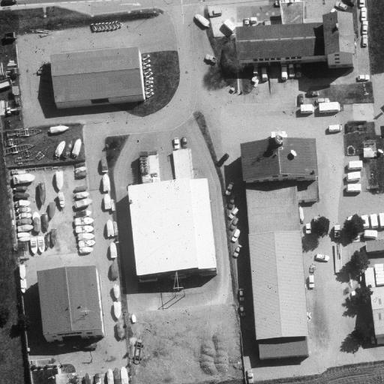
Interpretation of Aerial Photography
Interpretation of aerial photography is a problem domain in both computer vision and registration.

Slide 34
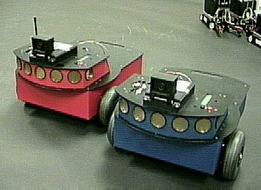
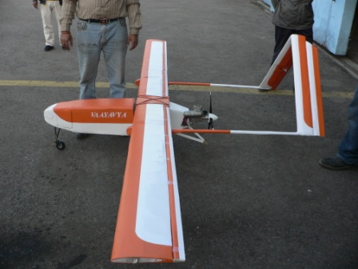
Autonomous Vehicles
Land, Underwater, Space

Slide 35
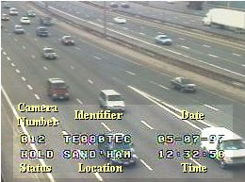
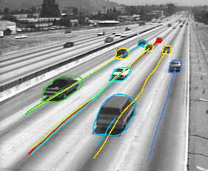
Traffic Monitoring

Slide 36
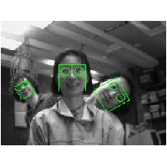
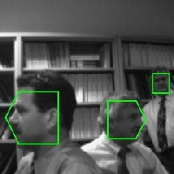
Face Detection

Slide 37
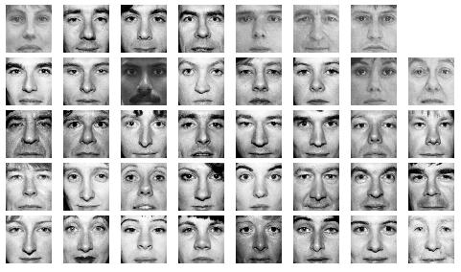
Face Recognition

Slide 38
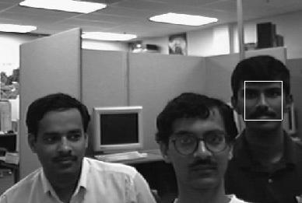
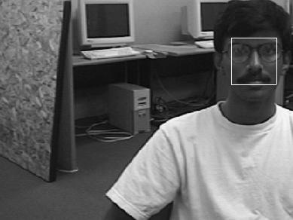
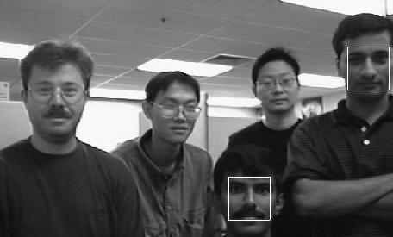
Face Detection/Recognition Research at UNR

Slide 39
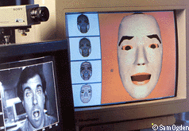
Facial Expression Recognition

Slide 40


Face Tracking

Slide 41


Face Tracking (cont’d)

Slide 42

Hand Gesture Recognition
Smart Human-Computer User Interfaces
Sign Language Recognition

Slide 43
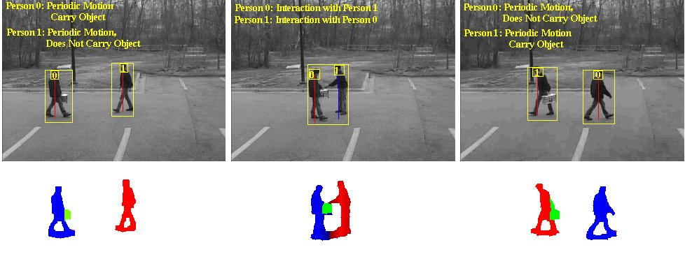
Human Activity Recognition

Slide 44
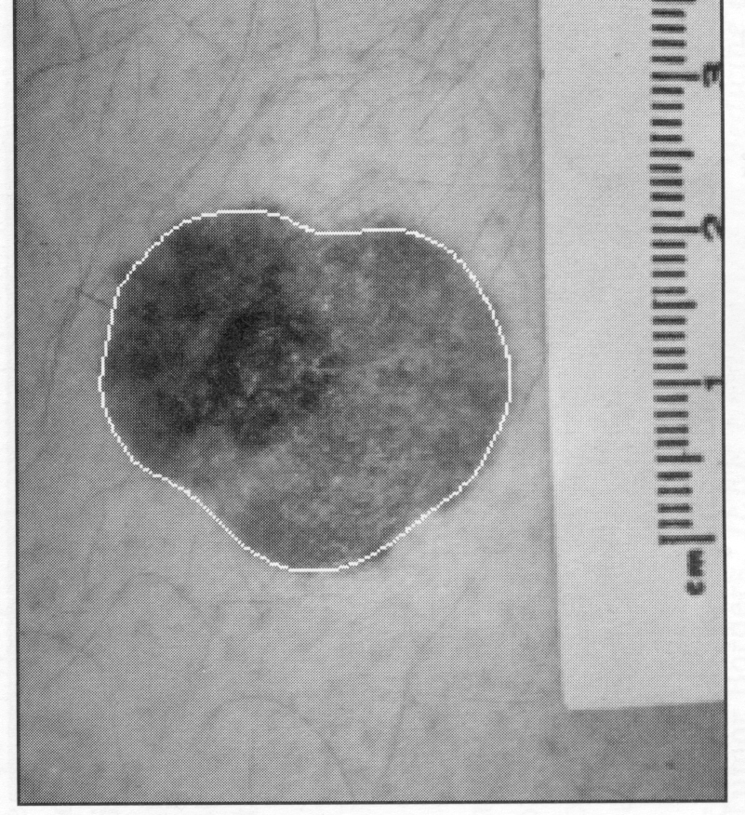
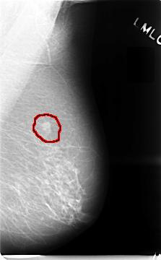
Medical Applications
skin cancer breast cancer

Slide 45
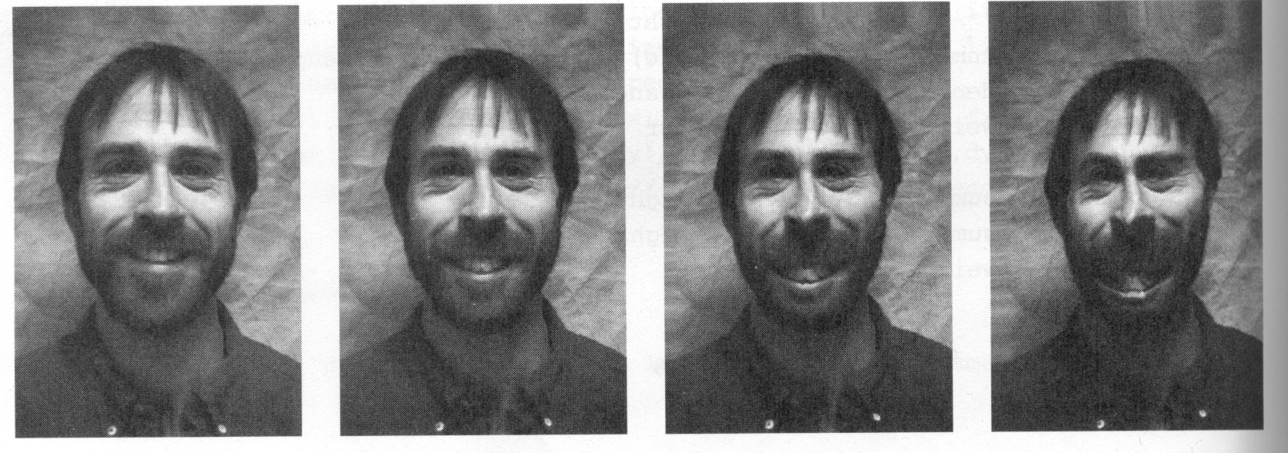
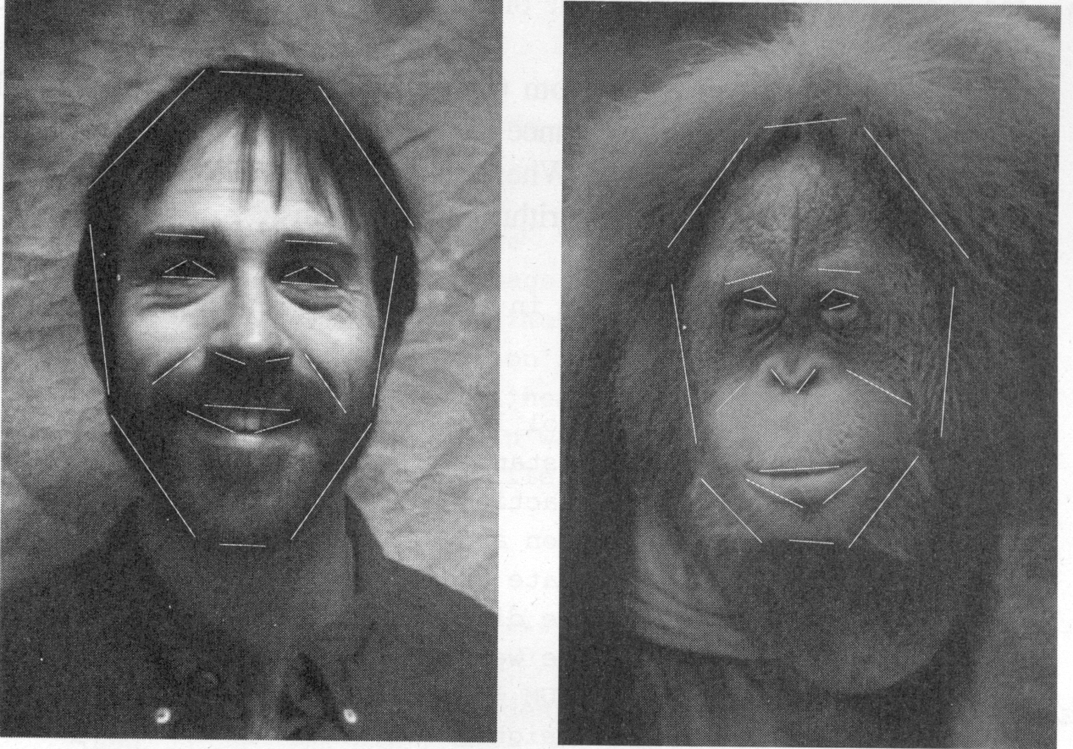
Morphing

Slide 46
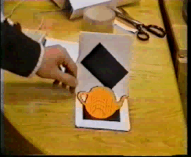
Inserting Artificial Objects into a Scene

Slide 47
Companies In this Field In India
Sarnoff Corporation
Kritikal Solutions
National Instruments
GE Laboratories
Ittiam, Bangalore
Interra Systems, Noida
Yahoo India (Multimedia Searching)
nVidia Graphics, Pune (have high requirements)
Microsoft research
DRDO labs
ISRO labs
…

Slide 48
Neighborhood Operations in Images

Slide 49
Basic Relationships Between Pixels
Neighborhood
Adjacency
Connectivity
Paths
Regions and boundaries

Slide 50
Basic Relationships Between Pixels
Neighbors of a pixel p at coordinates (x,y)
4-neighbors of p, denoted by N₄(p):
(x-1, y), (x+1, y), (x,y-1), and (x, y+1).
4 diagonal neighbors of p, denoted by N_{D}(p):
(x-1, y-1), (x+1, y+1), (x+1,y-1), and (x-1, y+1).
8 neighbors of p, denoted N₈(p)
N₈(p) = N₄(p) U N_{D}(p)

Slide 51
Basic Relationships Between Pixels
Adjacency
Let V be the set of intensity values
4-adjacency: Two pixels p and q with values from V are 4-adjacent if q is in the set N₄(p).
8-adjacency: Two pixels p and q with values from V are 8-adjacent if q is in the set N₈(p).

Slide 52
Basic Relationships Between Pixels
Adjacency
Let V be the set of intensity values
m-adjacency: Two pixels p and q with values from V are m-adjacent if
(i) q is in the set N₄(p), or
(ii) q is in the set N_{D}(p) and the set N₄(p) ∩ N₄(p) has no pixels whose values are from V.

Slide 53
Basic Relationships Between Pixels
Path
A (digital) path (or curve) from pixel p with coordinates (x₀, y₀) to pixel q with coordinates (x_{n}, y_{n}) is a sequence of distinct pixels with coordinates
(x₀, y₀), (x₁, y₁), …, (x_{n}, y_{n})
Where (x_{i}, y_{i}) and (x_{i-1}, y_{i-1}) are adjacent for 1 ≤ i ≤ n.
Here n is the length of the path.
If (x₀, y₀) = (x_{n}, y_{n}), the path is closed path.
We can define 4-, 8-, and m-paths based on the type of adjacency used.

Slide 54
Examples: Adjacency and Path
V = {1, 2}
0 1 1 0 1 1 0 1 1
0 2 0 0 2 0 0 2 0
0 0 1 0 0 1 0 0 1

Slide 55
Examples: Adjacency and Path
V = {1, 2}
0 1 1 0 1 1 0 1 1
0 2 0 0 2 0 0 2 0
0 0 1 0 0 1 0 0 1
8-adjacent

Slide 56
Examples: Adjacency and Path
V = {1, 2}
0 1 1 0 1 1 0 1 1
0 2 0 0 2 0 0 2 0
0 0 1 0 0 1 0 0 1
8-adjacent
m-adjacent

Slide 57
Examples: Adjacency and Path
V = {1, 2}
01,1 11,2 11,3 0 1 1 0 1 1
02,1 22,2 02,3 0 2 0 0 2 0
03,1 03,2 13,3 0 0 1 0 0 1
8-adjacent
m-adjacent
The 8-path from (1,3) to (3,3):
(1,3), (1,2), (2,2), (3,3)
(1,3), (2,2), (3,3)
The m-path from (1,3) to (3,3):
(1,3), (1,2), (2,2), (3,3)

Slide 58
Basic Relationships Between Pixels
Connected in S
Let S represent a subset of pixels in an image. Two pixels p with coordinates (x₀, y₀) and q with coordinates (x_{n}, y_{n}) are said to be connected in S if there exists a path
(x₀, y₀), (x₁, y₁), …, (x_{n}, y_{n})
Where

Slide 59
Basic Relationships Between Pixels
Let S represent a subset of pixels in an image
For every pixel p in S, the set of pixels in S that are connected to p is called a connected component of S.
If S has only one connected component, then S is called Connected Set.
We call R a region of the image if R is a connected set
Two regions, R_{i} and R_{j} are said to be adjacent if their union forms a connected set.
Regions that are not to be adjacent are said to be disjoint.

Slide 60
Basic Relationships Between Pixels
Boundary (or border)
The boundary of the region R is the set of pixels in the region that have one or more neighbors that are not in R.
If R happens to be an entire image, then its boundary is defined as the set of pixels in the first and last rows and columns of the image.
Foreground and background
An image contains K disjoint regions, R_{k}, k = 1, 2, …, K. Let R_{u} denote the union of all the K regions, and let (R_{u})^{c} denote its complement.
All the points in R_{u} is called foreground;
All the points in (R_{u})^{c} is called background.

Slide 61
Question 1
In the following arrangement of pixels, are the two regions (of 1s) adjacent? (if 8-adjacency is used)
1 1 1
1 0 1
0 1 0
0 0 1
1 1 1
1 1 1
Region 1
Region 2

Slide 62
Question 2
In the following arrangement of pixels, are the two parts (of 1s) adjacent? (if 4-adjacency is used)
1 1 1
1 0 1
0 1 0
0 0 1
1 1 1
1 1 1
Part 1
Part 2

Slide 63
Question 3
In the following arrangement of pixels, the circled point is part of the boundary of the 1-valued pixels if 8-adjacency is used, true or false?
0 0 0 0 0
0 1 1 0 0
0 1 1 0 0
0 1 1 1 0
0 1 1 1 0
0 0 0 0 0

Slide 64
Question 4
In the following arrangement of pixels, the circled point is part of the boundary of the 1-valued pixels if 4-adjacency is used, true or false?
0 0 0 0 0
0 1 1 0 0
0 1 1 0 0
0 1 1 1 0
0 1 1 1 0
0 0 0 0 0

Slide 65
Distance Measures
Given pixels p, q and z with coordinates (x, y), (s, t), (u, v) respectively, the distance function D has following properties:
D(p, q) ≥ 0 [D(p, q) = 0, iff p = q]
D(p, q) = D(q, p)
D(p, z) ≤ D(p, q) + D(q, z)

Slide 66
Distance Measures
The following are the different Distance measures:
a. Euclidean Distance :
D_{e}(p, q) = [(x-s)² + (y-t)²]^{1/2}
b. City Block Distance:
D₄(p, q) = |x-s| + |y-t|
c. Chess Board Distance:
D₈(p, q) = max(|x-s|, |y-t|)

Slide 67
Question 5
In the following arrangement of pixels, what’s the value of the chessboard distance between the circled two points?
0 0 0 0 0
0 0 1 1 0
0 1 1 0 0
0 1 0 0 0
0 0 0 0 0
0 0 0 0 0

Slide 68
Question 6
In the following arrangement of pixels, what’s the value of the city-block distance between the circled two points?
0 0 0 0 0
0 0 1 1 0
0 1 1 0 0
0 1 0 0 0
0 0 0 0 0
0 0 0 0 0

Slide 69
Introduction to Mathematical Operations in DIP
Array vs. Matrix Operation
Array product
operator
Array product
Matrix product
operator
Matrix product

Slide 70
Introduction to Mathematical Operations in DIP
Linear vs. Nonlinear Operation
H is said to be a linear operator;
H is said to be a nonlinear operator if it does not meet the above qualification.
Additivity
Homogeneity

Slide 71
Arithmetic Operations
Arithmetic operations between images are array operations. The four arithmetic operations are denoted as
s(x,y) = f(x,y) + g(x,y)
d(x,y) = f(x,y) – g(x,y)
p(x,y) = f(x,y) × g(x,y)
v(x,y) = f(x,y) ÷ g(x,y)

Slide 72
Set and Logical Operations

Slide 73
Image Transform
A particularly important class of 2-D linear transforms, denoted T(u, v)

Slide 74
Image Transform
Given T(u, v), the original image f(x, y) can be recoverd using the inverse tranformation of T(u, v).

Slide 75
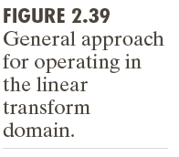
Image Transform

Slide 76
2-D Fourier Transform

